Slide 1
Vehicle Identification

Slide 2
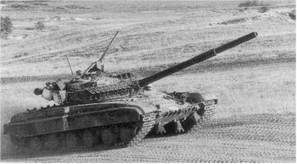

Slide 3
KEY RECOGNITION FEATURES
Vehicle Hull: well-sloped glacis plate with driver’s position top center, distinctive V splash plate on glacis, turret center of hull, engine and transmission rear. Unlike T-72, no exhaust outlet on left side of hull.
Turret: Circular turret, raised cupola with 12.7mm MG on right of roof, two stowage boxes right side of turret and one on turret rear (above which is the snorkel), three MG ammunition boxes on left side of turret. Infrared searchlight to left of 125mm gun with thermal sleeve and fume extractor.
Suspension: each side has six-road wheels (much smaller than those do on T-72) drive sprocket rear, idler front and four track-return rollers. Side skirts or grills type armor panels often installed over upper part of suspension. Unditching beam and fuel drums often carried rear.

Slide 4
T-64 Main Battle Tank
Crew 3
Armamament 125mm main gun 7.62mm coaxial machine gun
12.7mm AA MG smoke dischargers (either side of thegun)
Ammunition 36 x 115mm 300 x 12.7mm 2,000 x 7.62mm
Length 7.4 m Width 3.38 m w/o skirts 4.64 m w/ skirts Height 2.3 m
Weight 40,000 kg Engine model 5 DTF 5 cylinder opposed diesel - 700 hp
Max Road Speed 75 kph
Gradient 60% Side Slope 40%
Fuel Capacity 1000 lit Max Range 400 km - 550 w/aux tanks
Fording 1.8 m 5 m w/prep Verticle Obstacle 0.8 m Trench 2.28 m
Armor classified
NBC System Yes
Night Vision Equipment Yes - infra red

Slide 5
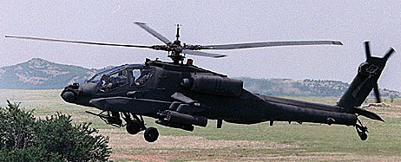

Slide 6
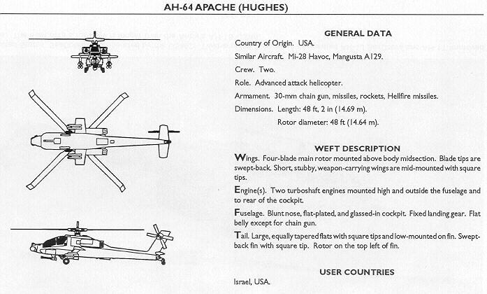
KEY RECOGNITION FEATURES

Slide 7
AH-64 Apache Helicopter
Length:. 48 feet / 14.6 meters Height:.12 feet / 3.6 meters
Max.Weight:. 21.000 pounds / 9.525 kilograms
Max.speed:. 184 miles per hour / 296 kilometers per hour
Max.Range:. 300 miles / 482 kilometers Cieling:. 21.000 feet / 6400 meters
Engines:.2 General Electric GE T700-GE-701 turboshafts each rated at 1.700 hp
Armament: 1 Chain Gun M230 30 mm. cannon, 16 Hellfire anti-tank missiles, 76 rockets, Stinger or Starstreak air to air missiles
Crew: 1 pilot and 1 co-pilot weapons operator

Slide 8
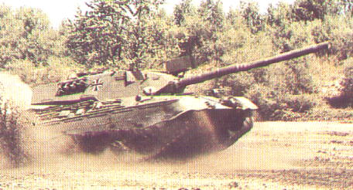

Slide 9
KEY RECOGNITION FEATURES
Vehicle Hull: Well sloped glacis plate leads up to horizontal hull top extending right to rear of hull, drivers hatch in right side of roof to immediate rear of glacis plate, turret center, engine rear, hull rear slopes slightly inwards. Hull sides above suspension slope inwards with horizontal louvers above rear drive sprocket.
Turret: Cast turret sides sloping inwards, external mantle and 105 mm gun with thermal sleeve and fume extractor, infra-red / white light searchlight often mounted above gun mantle, stowage baskets on rear of turret, smoke grenade discharge on turret sides towards rear.
Suspension: each side has seven road wheels; idler front, drive sprocket rear, four track-return rollers. Upper part often covered by skirts.

Slide 10
Leopard 1 Main Battle Tank
Crew 4
Armamament 1 x 105 mm 1 x 7.62 mm machine gun coaxial
1 x 7.62 mm machine gun AA 2 x 4 smoke dischargers
Ammunition 60 x 105 mm 5,000 x 7.62 mm
Length 7.09 m Width 3.25 m Height 2.613 m Weight 40,000 kg
Engine MTU MB 838 Ca M500, 10 cylinder multi fueldeveloping 830hp at 2,200rpm
Max Road Speed 65 kmh
Gradient 60% Side Slope 30%
Fuel Capacity 955 lit Max Range 600 km
Fording 2.25 m 4m w/prep Verticle Obstacle 1.15 m Trench 3 m
Armor 70mm(max estimate) steel
NBC System Yes
Night Vision Equipment Yes - was infra red now passive in some armies

Slide 11
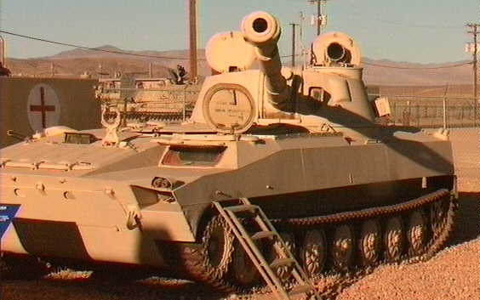

Slide 12
KEY RECOGNITION FEATURES
Vehicle Hull: Low profile turret mounted at rear of long hull.
Turret: 122mm howitzer does not overhand front of chassis, has double baffle muzzle brake and fume extractor.
Suspension: Has seven large road wheels, drive sprocket front, idler rear, not track-return rollers.

Slide 13
2S1 M1974
Crew 4
Armamament 1 x 122mm
Ammunition 40 x 122
Length 7.26 m Width 2.85 m Height 2.715 m Weight 15,700 kg
Engine YaMZ-238V, V-8 water cooled diesel developing 240hp at 2,100 rpm
Max Road Speed 61.5 kmh
Gradient 60% Side Slope 40%
Fuel Capacity 550 lit Max Range 500 km
Fording amphibious Verticle Obstacle 1.1 m Trench 2.75 m
Armor 20mm(max) - Steel
NBC System Yes
Night Vision Equipment Yes - infra red for driver and commander

Slide 14
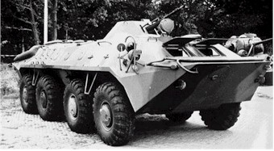

Slide 15
KEY RECOGNITION FEATURES
Vehicle Hull: Similar in appearance to BTR-60B but with small door in lower part of hull between second and third road wheels, trim vane folds back onto glacis plate (on BTR-60 it folds under nose), commanders hatch front right is slightly domed, water jet opening in hull rear has two-pieces cover with hinge at top. BTR-80 also has different hull rear.
Turret: Commander and driver sit front, turret on roof in line with second road wheel, horizontal hull top which slopes down at far rear, exhaust pipe each side of hull at rear.
Suspension: Four large rubber-typed roads wheel each side with slightly larger gap between second and third road wheel.

Slide 16
BTR 70
Crew 2+9
Armamament 14.5mm machine gun(main) 1 x 7.62 mm machine gun(coaxial)
Ammunition 500 X 14.5 mm 2,000 x 7.62mm
Length 7.535 m Width 2.8 m Height 2.235 m Weight 11,500kg
Engine 2 x ZMZ-4905 6 cylinder petrol devoping 120hp
Max Road Speed 80 kmh
Gradient 60% Side Slope 30%
Fuel Capacity 350 lit Max Range 600 km
Fording Amphibious Verticle Obstacle 0.5 m Trench 2 m
Armor Steel-9mm max
NBC System Yes
Night Vision Equipment Yes(infra red)

Slide 17
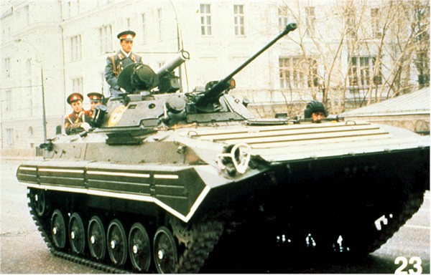

Slide 18
KEY RECOGNITION FEATURES
Vehicle Hull: Pointed nose with almost horizontal ribbed glacis plate, driver front left engine compartment louvers in roof to right, turret slightly to rear of vehicle, troop compartment rear with two roof hatches. Vertical hull rear with two bulged doors opening rear. Similar in appearance to BMP-1 but with different turret and wider hull.
Turret: has long-barreled 30 mm cannon with muzzle brake, three forward-firing smoke discharge each sides of turret, ATGW launcher in center of turret at rear. Four firing ports in left side of hull and three in right plus one in each rear door.
Suspension: each side has six road wheels, drive sprocket front, idler rear, track-return rollers covered by skirts with horizontal ribs.

Slide 19
BMP 2
Crew 3 + 7
Armamament 30mm cannon 1 x 7.62 mm machine gun
Spandrel ATGW launcher 2 x 3 smoke dischargers
Ammunition 500 x 30mm 2,000 x 7.62mm 4 Spandrel ATGW
Length 6.735 m Width 3.15 m Height 2.45 m Weight 14,300kg
Engine Model UTD-20 6-cylinder diesel developing 285/300hp at 2,600rpm
Max Road Speed 65 kmh
Gradient 60% Side Slope 40%
Fuel Capacity 462 lit Max Range 600km
Fording Amphibious Verticle Obstacle 0.7 m Trench 2.5 m
Armor Steel
NBC System Yes
Night Vision Equipment Yes

Slide 20
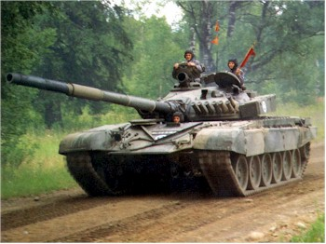

Slide 21
KEY RECOGNITION FEATURES
Vehicle Hull: well sloped glacis plate with drivers position top center, distinctive V splash plate on glacis, turret center of hull, engine and transmission rear, exhaust outlet on left side of hull above last road wheel station.
Turret: Circular turret, raised cupola with external 12.7mm MG on right of roof, stowage boxes right, snorkel left side, Infra-red searchlight to right of 125mm gun with thermal sleeve and fume extractor. Unditching beam and long-range fuel tanks sometimes fitted rear.
Suspension: each side has six road wheels, drive sprocket rear, idler front and three track-return rollers. Upper part often covered by rubber skirt or foldout armor panels over forward wheel stations.

Slide 22
T-72 Main Battle Tank
Crew 3
Armamament 125mm main gun 7.62mm coaxial machine gun
12.7mm AA MG smoke dischargers (number depends on model)
Ammunition 45 x 125mm 300 x 12.7mm 2,000 x 7.62mm
Length 6.95m Width 3.6m Height 2.37m Weight 44,500kg
Engine V46 V-12 diesel 840 hp at 2,000 rpm
Max Road Speed 80 kph
Gradient 60% Side Slope 40%
Fuel Capacity 1,000 lit Max Range 450 km
Fording 1.8 m 5 m w/prep Verticle Obstacle 0.85m Trench 2.8m
Armor Classified
NBC System Yes
Night Vision Equipment Yes

Slide 23
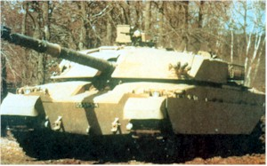

Slide 24
KEY RECOGNITION FEATURES
Vehicle Hull: Front idlers project ahead of nose which slopes under hull, well sloped glacis plate with drivers hatch recessed in center, turret center, slightly raised engine compartment rear, hull rear slopes inwards at sharp angle.
Turret: has well-sloped front angled to rear, turret sides vertical. Commander’s cupola on right side with external 7.62mm MG, opening in right side of turret for TOGS.
Suspension: each side has six road wheels, idler front, drive sprocket rear, four track-return rollers. Upper part of road wheels and suspension covered by skirts.

Slide 25
Challenger Main Battle Tank
Crew 4
Armamament 120 mm main gun 7.62 mm coaxial machine gun
7.62 mm anti-aircraft machine gun 2 x 5 smoke dischargers
Ammunition 64 x 120 mm 4,000 x 7.62mm
Length 8.327 m Width 3.518 m Height 2.5 m Weight 62,000 kg
Engine Perkins Engines Condor V-12 12 Cyl diesel 1200bhp at 2,300 rpm Max Road Speed 56 kph
Gradient 58% Side Slope 40%
Fuel Capacity 1592 lit Max Range 400 km Fording 1.07 m
Verticle Obstacle 0.9 m Trench 2.8 m
Armor Classified
NBC System Yes
Night Vision Equipment Yes

Slide 26
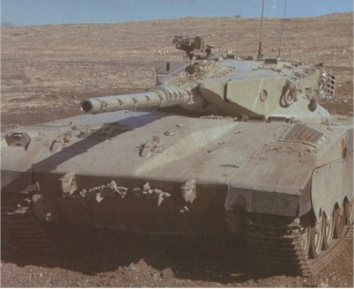

Slide 27
KEY RECOGNITION FEATURES
Vehicle Hull: Almost vertical front, well-sloped glacis plate with distinct bulge in right side for engine. Horizontal hull top extends right to rear, drivers hatch forward of turret on left side.
Turret: mounted slightly to rear of vehicle with distinctive pointed front, 105mm gun with thermal sleeve and fume extractor, large turret bustle with stowage rack that extends to hull rear, entry hatch in vertical hull rear.
Suspension: each side has six road wheels, drive sprocket front, idler rear and four track-return rollers. Upper part of suspension covered by skirts with wavy bottom.

Slide 28
Merkava Main Battle Tank
Crew 4
Armamament 105mm main gun 1 x 7.62 mm machine gun - coaxial
2x 7.62mm machine gun - anti aircraft 1 x 60mm mortar
Ammunition 62 x 105mm 10,000 x 7.62mm
Length 7.45m Width 3.7m Height 2.64m Weight 63,000kg
Engine Teledyne Continental AVDS-1790-6A V-12 diesel developing 900hp
Max Road Speed 46 kph
Gradient 70% Side Slope 38%
Fuel Capacity 900lit Max Range 400km
Fording 1.38 m 2m w/prep Verticle Obstacle 0.95m Trench 3 m
Armor Classified
NBC System Yes
Night Vision Equipment Yes

Slide 29
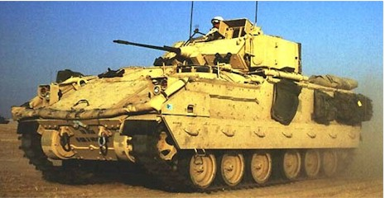

Slide 30
KEY RECOGNITION FEATURES
Vehicle Hull: High hull lines with well-sloped glacis plate, drivers hatch left side, horizontal hull top, turret center of roof. Large ramp at hull rear, hatch above rear troop compartment.
Turret: Has twin TOW ATGW launcher on left side, extensive external stowage with 25mm cannon front and 7.62mm MG right, two spherical firing ports with periscope above in each side of hull.
Suspension: Each side has six road wheels, drive sprocket front, idler rear, and two track-return rollers. Upper part of track and hull sides has appliqué` armor.

Slide 31
M2 / M3 Bradley Fighting Vehicle
Crew 3+6
Armamament 1 x 25 mm 1 x 7.62 mm machine gun - coaxial
2 x TOW ATGW launcher 2 x 4 smoke dischargers
Ammunition 900 x 25 mm 1,340 x 7.62 mm 7 x TOW ATGW
Length 6.453 m Width 3.2 m Height 2.972 m Weight 22, 590 kg
Engine Cummins VTA-903T turbocharged 8 cylinder diesel developing 500 hp at 2,600 rpm
Max Road Speed 66 kmh
Gradient 60% Side Slope 40%
Fuel Capacity 662 lit Max Range 483 km
Fording amphibious w/ prep Verticle Obstacle 0.914 m Trench 2.54 m
Armor Classified
NBC System Yes
Night Vision Equipment Yes - passive

Slide 32
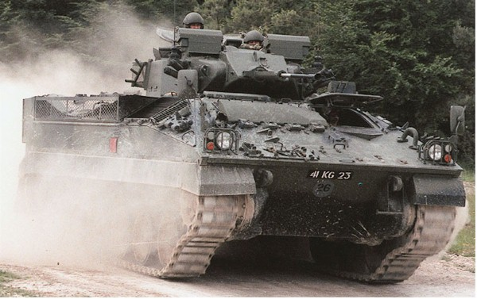

Slide 33
KEY RECOGNITION FEATURES
Vehicle Hull: High Hull with well sloped glacis plate, drivers hatch in upper left side and louvers to right, horizontal hull top with turret center, vertical hull rear with storage boxes each side of single door. No firing ports.
Turret: Has vertical sides with long barrel 30 mm RADEN cannon with flash eliminator and mounted in external mantel. Commander and gunner have hatches opening to rear and distinctive roof-mounted periscopes to their front, stowage baskets on turret rear. Troop compartment at rear has chamfered sides with stowage basket above.
Suspension: Suspension each sides has six road wheels, drive sprocket front, idler rear and three track-return rollers covered by skirts.

Slide 34
Warrior
Crew 3 + 7
Armamament 30 mm cannon 7.62 mm machine gun 2 x 4 smoke dischargers
Ammunition
Length 6.34 m Width 3.034 m Height 2.791 m Weight 24,500 kg
Engine Perkins CV8 TCA V-8 diesel developing 550hp at 2,300 rpm
Max Road Speed 75 kph
Gradient 60% Side Slope 40%
Fuel Capacity 770 lit Max Range 660 km
Fording 1.3 m Verticle Obstacle 0.75 m Trench 2.5 m
Armor Classified
NBC System Yes
Night Vision Equipment Yes (passive)

Slide 35
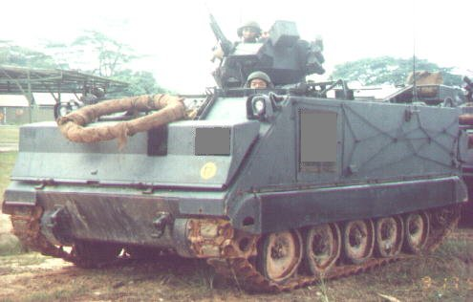

Slide 36
KEY RECOGNITION FEATURES
Vehicle Hull: Boxed-shaped hull with front slopping at 60 degree to rear, horizontal roof, vertical hull sides with no firing ports or vision devices.
Turret: Drivers circular hatch front left with louvers to right, commanders cupola with externally mounted 12.7mm M2 HB MG in center of roof with rectangular hatch to rear. External box-type fuel tanks each side of ramp on hull rear.
Suspension: each side has five road wheels, drive sprocket front, idler rear, no track return rollers, upper part of track normally covered by rubber skirt.

Slide 37
M113 APC
Crew 2+11 Armamament 1 x 12.7mm
Ammunition 2000 x 12.7mm
Length 4.863m Width 2.686m Height 1.85m Weight 11,341 kg
Engine Detriot diesel model 6V-53, 6 cylinder water cooled diesel developing 215bhp at 2800rpm
Max Road Speed 67 kmh
Gradient 60% Side Slope 40%
Fuel Capacity 360 lit Max Range 483 km
Fording amphibious
Verticle Obstacle 0.61 m Trench 1.68 m
Armor 38mm - Aluminum
NBC System
Optional Night Vision Equipment Yes(passive or infra red - driver)

Slide 38
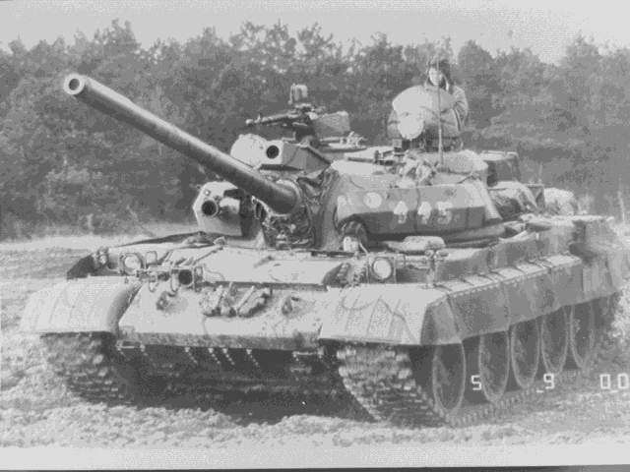

Slide 39
KEY RECOGNITION FEATURES
Vehicle Hull: well sloped glacis plate with splash board mid-way up, horizontal hull top with drivers hatch front left, turret center, engine compartment rear. Vertical hull rear.
Turret: Circular turret and well sloped all around, loader’s copula on right normally mounts 12.7mm AA MG. 100 mm gun has no thermal sleeve but bore evacuator to immediate rear of muzzle. Infrared searchlight right of main armament.
Suspension: each side has five road wheels, drive sprocket rear, idler front and no track-return rollers or skirts, exhaust pipe on left track guard above fourth / fifth road wheel, distinct gap between first and second road wheels. Flat fuel / oil stowage tanks right side of hull above track.

Slide 40
T54 \ 55 Main Battle Tank
Crew 4
Armamament 100 mm main gun 7.62mm coaxial machine gun
7.62mm machine gun (bow) 12.7mm AA MG
Ammunition 34 x 100mm 500 x 12.7mm 3,000 x 7.62mm
Length 6.45 m Width 3.27 m Height 2.4 m Weight 36,000 kg
Engine V-12 water cooled diesel developing 520hp at 2,000rpm
Max Road Speed 48 kph
Gradient 60% Side Slope 40%
Fuel Capacity 812lit Max Range 400 km - 600 km with aux tanks
Fording 1.4 m 4.5m w/prep Verticle Obstacle 0.8 m Trench 2.7 m
Armor Steel - 203mm max
NBC System No
Night Vision Equipment Yes - infra red
Manufacturer: Czechoslovakian, Poland, former Soviet State Factories, and China as Type 59

Slide 41
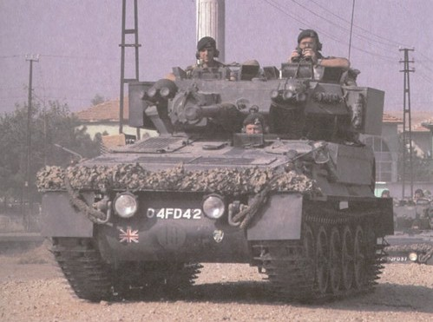

Slide 42
KEY RECOGNITION FEATURES
Vehicle Hull: rounded nose with well sloped glacis plate, drivers hatch in upper left side and louvers to right, horizontal hull top, vertical hull rear with oblong stowage box.
Turret: on hull top to rear with short-barreled 76mm gun, no muzzle brake or fume extractor, sight to rear of 76mm gun. Upper part of turret sides slopes inwards towards hull roof. Stowage boxes each side of turret.
Suspension: each side has five large road wheels, drive sprocket front, idler rear, and no track-return rollers. Original flotation screen round hull top has been removed from British Army vehicles. Long stowage box above rear road wheels.

Slide 43
Scorpion
Crew 3
Armamament 76mm cannon 7.62 mm machine gun 2 x 4 smoke dischargers
Ammunition 40 x 76 mm 3,000 x 7.62mm
Length 4.794m Width 2.235m Height 2.102m Weight 8073 kg
Engine Jaguar J60 4.2 lit 6 cylinder petrol developing 160hpat 4,750 rpm
Max Road Speed 80.5 kph
Gradient 60% Side Slope 40%
Fuel Capacity 423 lit Max Range 644 km Fording 1.067 m
amphibious with prep
Verticle Obstacle 0.5 m Trench 2.057 m
Armor Classified
NBC System Yes
Night Vision Equipment Yes

Slide 44
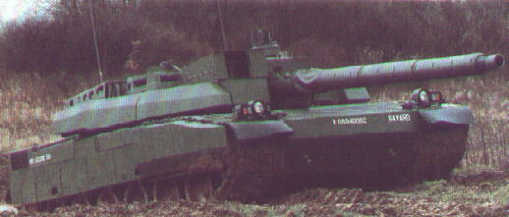

Slide 45
KEY RECOGNITION FEATURES
Vertical Hull: front which then slopes back under front of hull, very well sloped glacis plate, turret centre, slightly raised engine compartment at rear. Hull rear is vertical with horizontal louvers.
Turret: front and sides have vertical lower part with chamfer to upper part, distinctive array of periscopes around upper part of forward part of turret roof. Large periscope sight on left side of turret roof externally mounted 7.62-mm machine gun.
Suspension: has six road wheels either side with idler front, drive sprocket rear, and track return rollers. Armored skirts cover upper part of suspension with those above the front two road wheels being thicker.

Slide 46
Leclere Main Battle Tank
Crew 3
Armamament 120mm main gun 12.7mm coaxial machine gun
7.62mm anti-aircraft machine gun 3x 9 smoke dischargers
Ammunition 40 x 120mm
Length 6.88 m Width 3.71 m Height 2.46 m Weight 53,000 kg
Engine UNI-DIESEL-1500 V8X 1500hp
Max Road Speed 75 kph
Gradient 60% Side Slope 30%
Fuel Capacity 1,300 lit Max Range 550 km
Fording 1 m Verticle Obstacle 1.25 m Trench 3 m
Armor Classified
NBC System Yes
Night Vision Equipment Yes (passive)

Slide 47
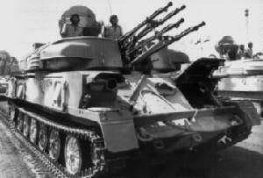

Slide 48
KEY RECOGNITION FEATURES
Vehicle Hull: Large square turret with four 23-mm cannon in forward part and large dish-shaped radar antenna over turret rear.
Turret: Driver front, turret center, engine rear.
Suspension: Six large road wheels with idler front drive sprocket rear, no return rollers.

Slide 49
ZSU 23-4
Crew 4
Armamament 4 x 23 mm cannon
Ammunition 2,000 x 23mm
Length 6.54 m Width 2.95 m Height 2.25 m Weight 20,500 kg
Engine Model V-6R, 6-cylinder in line water cooled diesel developing 280hp
Max Road Speed 44 kmh
Gradient 60% Side Slope 30%
Fuel Capacity 250 lit Max Range 450 km
Fording 1.07 m Verticle Obstacle 1.1 m Trench 2.8 m
Armor Steel (15 mm - max)
NBC System Yes
Night Vision Equipment Yes(driver only)

Slide 50
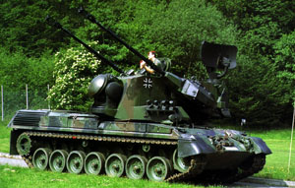

Slide 51
KEY RECOGNITION FEATURES
Vehicle Hull: Based on Leopard 1MTB chassis with much larger turret.
Surveillance: Radar above turret rear that retracts for travelling, tracking radar on turret front.
Turret: Twin 35mm cannon with muzzle velocity measuring equipment mounted externally on each side of turret.

Slide 52
Gepard
Crew 3
Armamament 2 x 35 mm 2 x 4 smoke dischargers
Ammunition 620 AA 40 AP
Length 6.85 m Width 3.37 m Height 3.01 m Weight 47,300 kg
Engine MTU MB 838 Ca M500 10 cylinder multi fuel developing 830hp at 2,200rpm
Max Road Speed 65 kmh
Gradient 60% Side Slope 30%
Fuel Capacity 985 lit Max Range 550 km
Fording 2.5 m Verticle Obstacle 1.15 m Trench 3 m
Armor Steel(40mm)
NBC System Yes
Night Vision Equipment Yes - driver

Slide 53
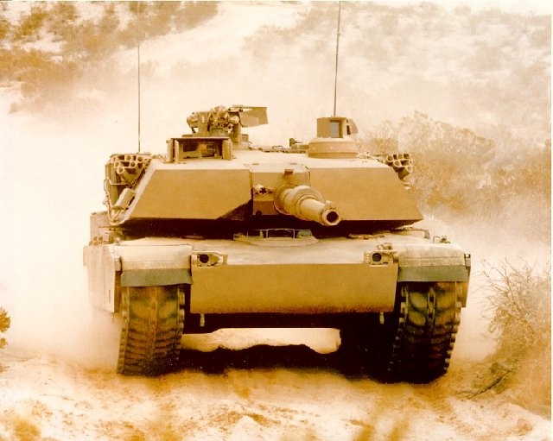

Slide 54
KEY RECOGNITION FEATURES
Vehicle Hull: Nose slopes back under hull, almost horizontal glacis plate, drivers hatch center, raised engine compartment rear. Hull rear vertical with air louvers in upper part.
Turret: Large turret with almost vertical front that slopes to rear, hull sides slope inwards with bustle extending well to rear, stowage box and basket on each side of turret towards rear. Rectangular gunners sight on right side of turret roof forward of commanders cupola which has externally mounted 12.7 mm MG. 105 mm gun has fume extractor and muzzle reference system.
Suspension: each side has seven-road wheel, drive sprocket rear, large idler front, two return rollers. Upper part of suspension, idler and most of drive sprocket covered by armored skirts.

Slide 55
M1 Abrams Main Battle Tank
Crew 4
Armamament 120mm main gun 7.62mm coaxial machine gun
7.62mm anti-aircraft machine gun .50 cal(12.7mm) AA MG 2 x 6 smoke dischargers
Ammunition 40 x 120mm 1,000 x .50cal 11,400 x 7.62mm 24 x smoke grenades
Length 7.918 m Width 3.653 m Height 2.375 m Weight 68 tons
Engine Textron Lycoming AGT 1500 gas turbine developing 1,500hp at 3,000rpm
Max Road Speed 72 kph
Gradient 60% Side Slope 40%
Fuel Capacity 505.3 gal Max Range 498 km Fording 1.2 m
Verticle Obstacle 1.2 m Trench 2.7 m
Armor Classified
NBC System Yes
Night Vision Equipment Yes

Slide 56
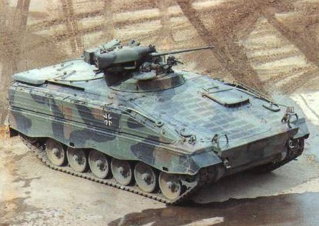

Slide 57
KEY RECOGNITION FEATURES
Vehicle Hull: Well sloped glacis plate with driver on left leading up to horizontal roof with vertical hull rear, hull sides slope inwards above suspension, power-operated ramp in hull rear.
Turret: Large turret with slopping front, sides and rear on roof with externally mounted 20mm cannon smoke grenade discharges on left.
Suspension: With six rubber-typed road wheels, drive sprocket front, idler rear, and three track-return rollers. Upper part of suspension normally covered by track guard.

Slide 58
Marder
Crew 3 + 6
Armamament 1 x 20 mm 1 x 7.62 mm machine gun coaxial 1 x 6 smoke dischargers
Ammunition 1250 x 20 mm 5,000 x 7.62 mm
Length 6.79 m Width 3.24 m Height 1.9 m Weight 29,200 kg
Engine MTU MB 833 Ea-500, 6 cylinder liquid cooled diesel developing 600hp at 2,200rpm
Max Road Speed 75 kmh
Gradient 60% Side Slope 30%
Fuel Capacity 652 lit Max Range 520 km
Fording 1.5 m 2 m w/prep Verticle Obstacle 1 m Trench 2.5 m
Armor Classified
NBC System Yes
Night Vision Equipment Yes - infra red

Slide 59
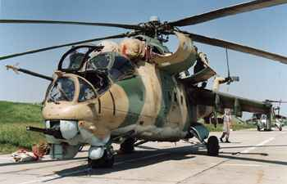

Slide 60
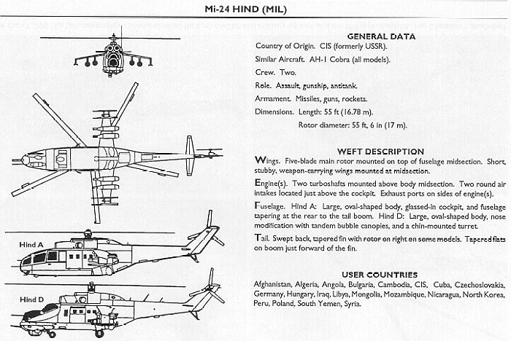
KEY RECOGNITION FEATURES

Slide 61
MI-24 HIND
PERFORMANCE
Vmax 208 mph (335 km/h)
Range 310 miles
Dynamic / static ceiling 14 100 / 2 300 ft
POWER PLANT
2x TV3-117 turboshafts
Power 1640 kW each
CREW
3 men -Pilot - Helicopter Commander -Pilot - Operator -Flight Engineer

